Slide 1
Service migration from AWS to Azure with no downtime
Krzysztof.Szyntar@dynatrace.com

Slide 2
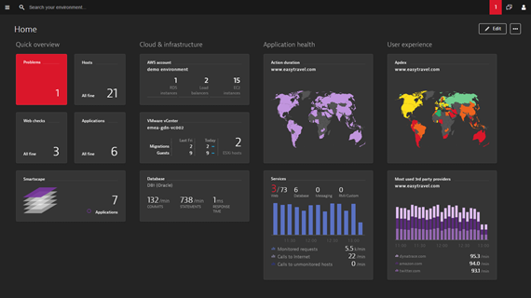
Dynatrace – Application Performance Management
Optimize performance of highly distributed applications down to the code level
Automatic baselining and event correlation
Two types of deployment
SaaS offering backed by AWS in 4 geographical regions
Managed on-prem offering, possible to install in any datacenter

Slide 3



Cluster migration - requirements
Frontend&Backend migration from AWS to Azure
About 1TB of data
Regions can be relatively close (e.g. US-EAST)
Minimize downtime
Infrastructure cost is not a primary concern
Dynatrace Managed Cluster
AWS Virginia VPC
Azure EAST US VNET

Slide 4





Dynatrace managed cluster architecture
Public Security
Gateway Tier
Storage Tier
Server Tier
Dynatrace Web UI
Dynatrace Agents
Dynatrace
Private SGW
Raw storage
Cassandra
ElasticSearch

Slide 5
Cluster migration – possible approaches
Full copy
Stop all services
Copy all binaries and data files
Reconfigure
Start the cluster in Azure
Backup and restore
Update backups
Stop all services
Restore the cluster from backup in Azure
Primary issue - downtime
Dynatrace Managed Cluster
AWS Virginia VPC
Azure EAST US VNET

Slide 6
Cluster migration by expansion
Connect virtual networks
Leverage horizontal scalability
Scale out – extend the cluster into Azure
Operate in 2 datacenters until data is replicated (or age-out)
Scale in – shrink the cluster again, removing the AWS part
Challenges
Spanning the VPCs
Longer migration
But possibly no downtime at all!
Dynatrace Managed Cluster
Dynatrace Managed Cluster
AWS Virginia VPC
Azure EAST US VNET

Slide 7
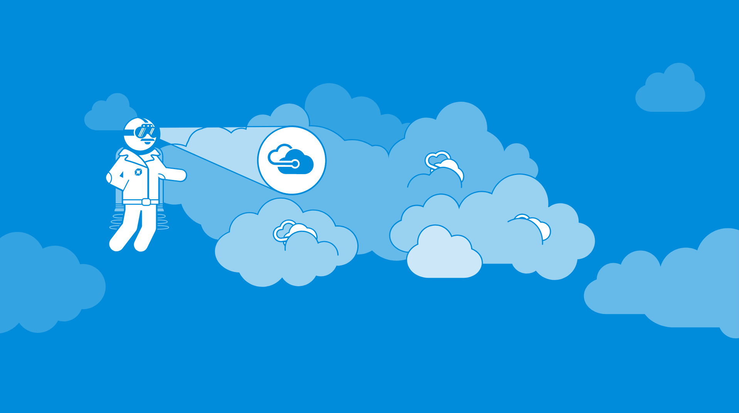
Azure, we’re coming

Slide 8
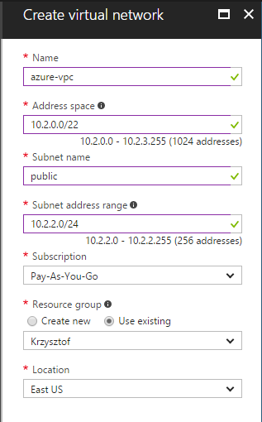
Preparation – virtual network
Create vnet in Azure
Pick vnet CIDR – must not overlap
Divide vnet into subnets
One subnet dedicated to VPN

Slide 9
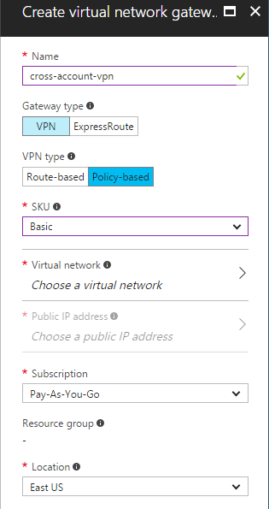
Preparation - VPN
Virtual Network Gateway
VPN
Policy-based (static routing)
Basic SKU (100Mbps)

Slide 10
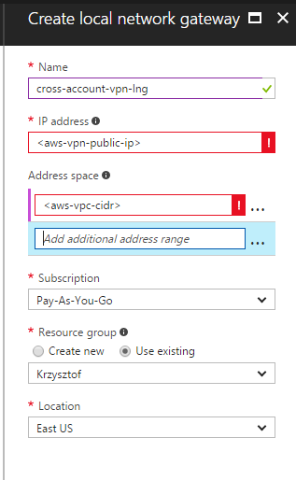
Preparation - VPN
Local network gateway
Public IP of the other VPN
CIDR block of the other network

Slide 11
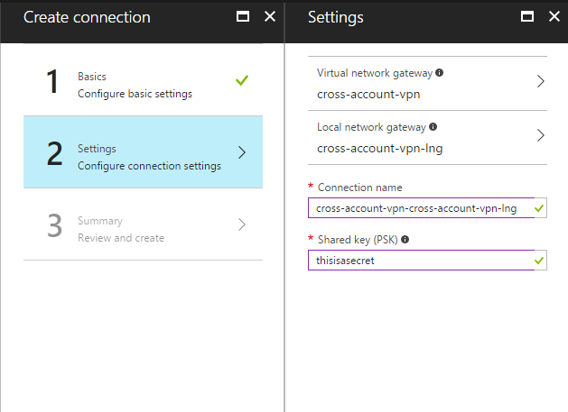
Preparation - VPN
Connection
Site-to-site
Association between VPN and local gateway
Define a secret

Slide 12
Preparation – connect Azure and Amazon
Not possible to connect Amazon VPN Gateway with Azure VPN Gateway
Need to have configurable VPN instance at least on one side
Pre-allocate Elastic IP in AWS
Launch OpenSwan software VPN on AWS EC2
disable Source/Destination Check
reduce MTU to avoid fragmentation
enable IP-forwarding
configure OpenSwan to connect to Azure VPN Gateway
Update the routing tables in AWS
/etc/ipsec.d/azure-tunnel.conf
conn azure-tunnel
type=tunnel authby=secret auto=start ikelifetime=8h keylife=1h pfs=no ike=3des-sha1-modp1024,aes128-sha1-modp1024 esp=3des-sha1,aes128-sha1 left=${privateIp} leftid=${elasticIp} leftnexthop=%defaultroute leftsubnet=${vpcCidr} right=${virtualGateway} rightsubnet=${destCidr}

Slide 13
Checking the connection
Latency
3.5ms avg RTT
Bandwidth
Constrained by the 100Mbps Gateway
In practive we get about 11MB/s
Stability of the tunnel
Need to monitor the tunnel and restart if needed

Slide 14





Connected clouds
xyz.dynatrace-managed.com
Public IP
gateway subnet
OpenSwan VPN
public subnets
public subnet
m4.2xlarge
In separate AZs
Ds4 v2
In availability set
private subnets
private subnet
private subnets
AWS Virginia VPC
Azure EAST US VNET

Slide 15
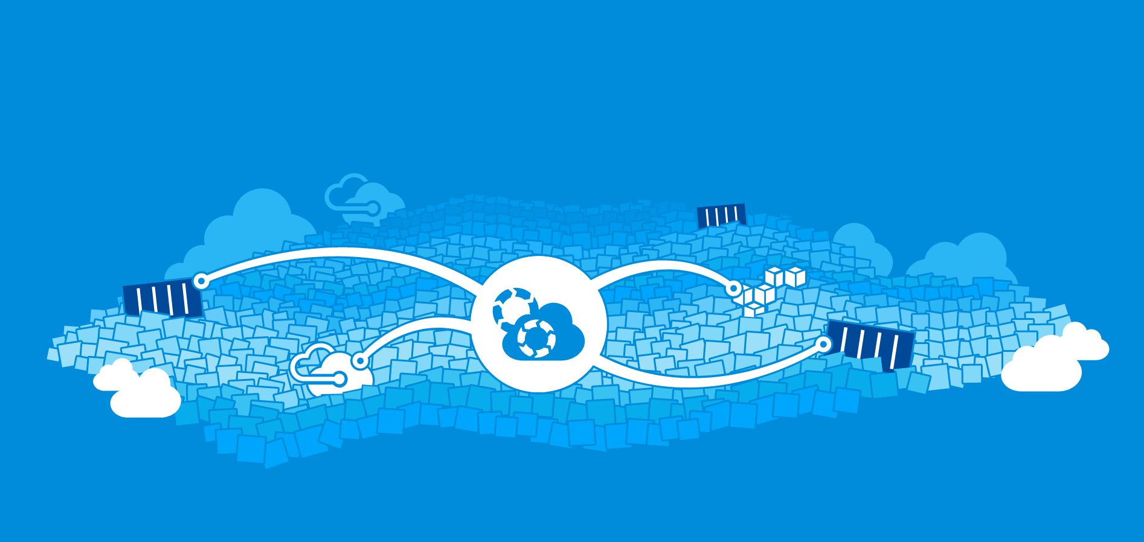
migration process started...

Slide 16
Moving data collectors and web ui tier
Stateless tier – no challenge with data transfer
New collectors automatically register and advertise their addresses
Old collectors can be gradually removed
Web ui - leverage simple DNS load balancing
New nodes’ addresses added to DNS
Old nodes gradually removed from DNS
Better option would be to have layer-7 cross-region LB

Slide 17
Data migration
Cassandra
ElasticSearch
Raw data in our own Transaction Data Store

Slide 18
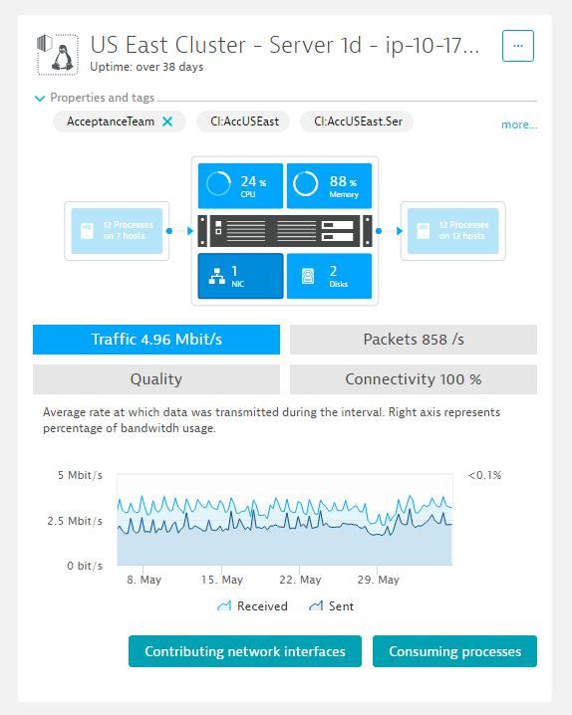
Data migration - Cassandra
Data profile
Time series and aggregates
Cassandra configured with replication factor=3
Not using multi-datacenter mode
Migration strategy
Trigger compaction to reduce data volume
Add new node in Azure
New node replicate the data before fully joining the cluster
Eventually old nodes can be removed one by one

Slide 19
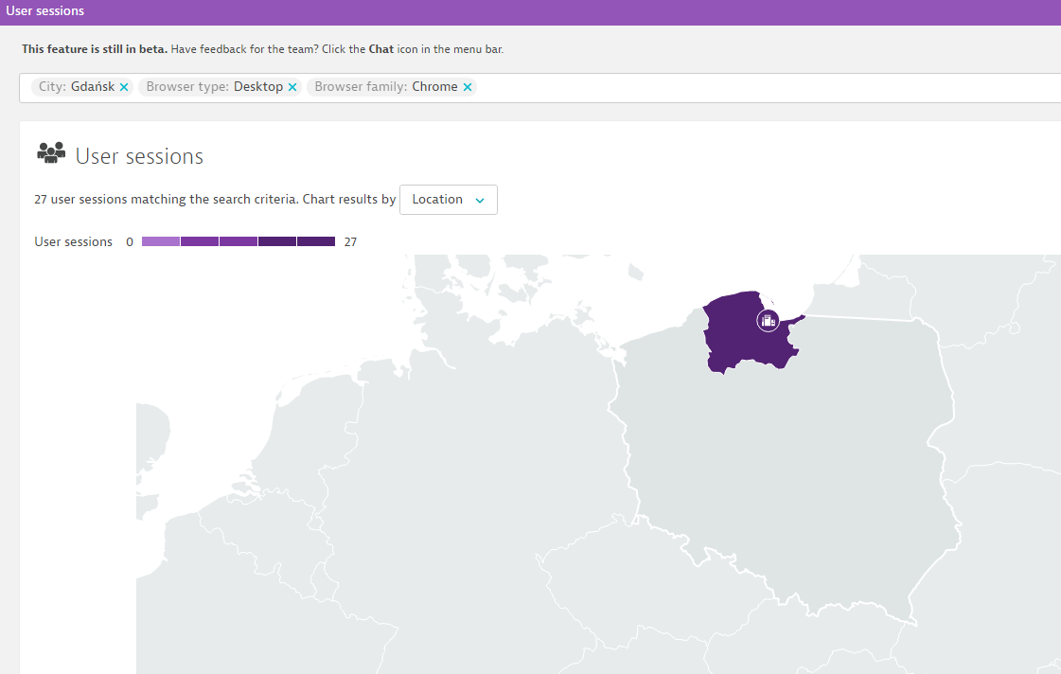
Data migration - ElasticSearch
Data profile
Real-User monitoring data – web page visits
Data stored in multiple indexes
Each index with multiple shards and 1 replica
Migration strategy
Adding new node – causing shard reallocation
Removing node in AWS

Slide 20


Slide 21
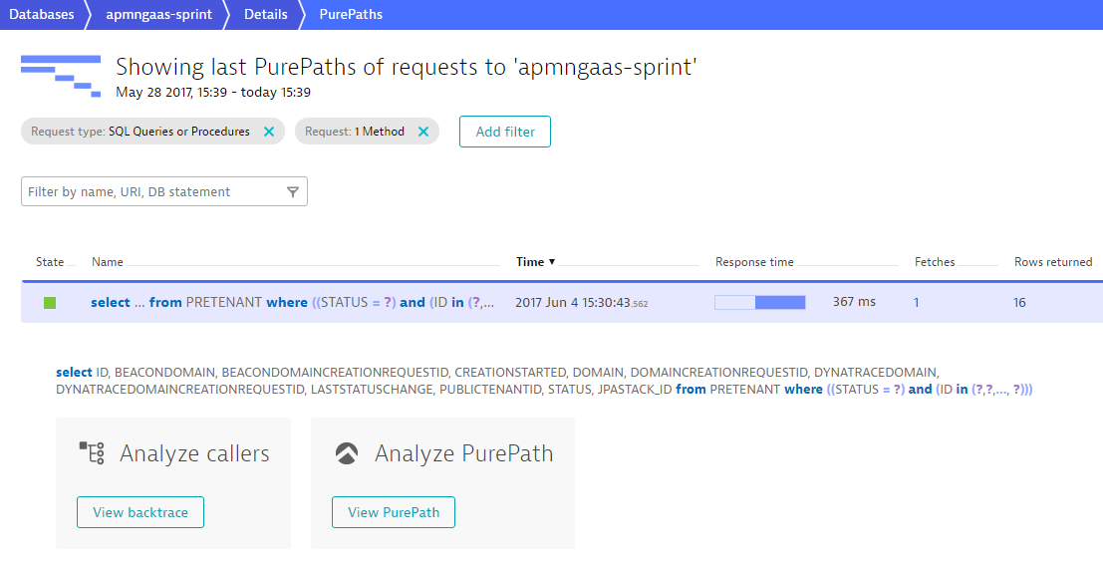
Migration of raw Transaction Store
Data profile
Raw data for on-demand analysis (e.g. stack traces, database statements)
Data analysis is distributed in cluster, but no replication mechanism
Data age-out in 7+ days
Migration strategy
Switch storage in AWS node into read-only mode
No migration per se, wait until the data age out

Slide 22
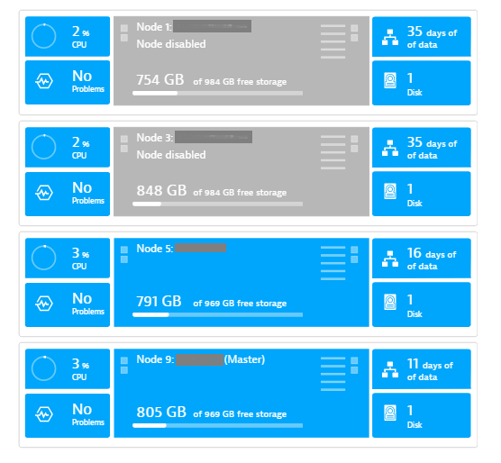
Summary
Hidden gems in distributed storage architecture
Get away with no specific multi-DC support
VPN connection
Possibly a bottle-neck
Need to be monitored and have failover
Cluster quorum adjustment to avoid brain-split scenarios
Viariable latency within the cluster
Avoid lock-in
Vendor-specific services

Slide 23
Resources
https://docs.microsoft.com/en-us/azure/vpn-gateway/vpn-gateway-howto-site-to-site-resource-manager-portal
https://docs.microsoft.com/en-us/azure/vpn-gateway/vpn-gateway-about-vpn-devices
https://github.com/xelerance/Openswan/wiki
https://www.elastic.co/guide/index.html
http://docs.datastax.com/en/cassandra/2.1/cassandra/architecture/architectureTOC.html

Slide 24
Questions

